Slide 1
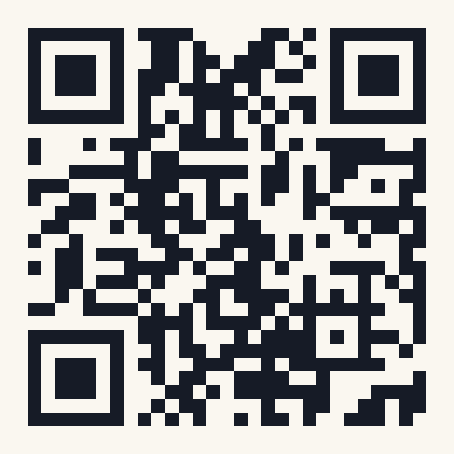
Golden Hour
AI BUSINESS OPERATIONS ASSOCIATE · PRESENTATION ROUND
An early-warning tool for project delivery
Mabel Nguyễn
Live app: golden-hour-pm.vercel.app
Hackathon submission · 19/10/2026
Code: github.com/Julie-hub-source/Golden_Hour_PM
Notes:
Good morning. I’m Mabel. Today I’ll walk you through Golden Hour, the tool I built for a hackathon on 19 October: what problem it solves, the assumptions I made, how it works, and most importantly how I built it with AI, from a business problem to a live app in three days.

Slide 2
About me

Slide 3

Nguyễn Cẩm Thạch - Mabel
ABOUT ME
Fresher Graduate of CS Major and Economics Minor
Current job: Junior IT Business Analyst at MoMo
Hobby: watching dramas, listening to music, eat everything
Golden Hour · Mabel Nguyễn
Notes:
Keep this under one minute. The point: I chose this problem because I have seen it from the inside, not because it sounded technical. [Fill in your role and background before presenting.]

Slide 4
Agenda

Slide 5
What we’ll cover
AGENDA
01
The challenge
04
How I built it with AI
02
Assumptions
05
Results & next steps
03
The solution & live demo
06
What I learned · Q&A
Golden Hour · Mabel Nguyễn
Notes:
Six parts. The longest are the demo and how I built it with AI, because that is what you asked to see.

Slide 6
The challenge
01

Slide 7
“Can you build a tool to surface where a project is really heading, and what to fix first, early enough to change the outcome?”
THE HACKATHON PROMPT · THE EARLY WARNING SYSTEM
Status ≠ reality
Hidden ripples
Too late
Wrong detail
Tools show what tasks should be doing, not what’s stuck
No one sees which delay will push everything after it
Managers find out at the deadline
Leadership gets updates too detailed or too vague to act on
Golden Hour · Mabel Nguyễn
Notes:
The prompt described a business problem, not a solution. Projects rarely fail all at once; they slip one blocked task at a time. These four pains are what I set out to solve.

Slide 8
Three questions the tool must answer on one screen
HOW I INTERPRETED IT
1
2
3
Where is the project heading?
What’s stuck, and who owns it?
What should we fix first?
Projected Prod date vs. the client commitment → buffer
Late tasks, blockers, owners and what depends on them
A ranked priority list, plus a what-if to test a delay
Golden Hour · Mabel Nguyễn
Notes:
Before writing any code, I turned the open prompt into three concrete questions. Every screen in the app exists to answer one of them. This kept the scope tight for a three-day build.

Slide 9
Three users, three different needs
WHO IT’S FOR
User | Needs | What Golden Hour gives them
PM | What to act on today | Priority list · what-if
Leadership / client | One clear signal | Buffer · Health (On track / Late)
Team members | Their own tasks | Task board · alerts · blockers
Golden Hour · Mabel Nguyễn
Notes:
The prompt said leadership gets updates that are too detailed or too vague. So I designed different levels: one number for leadership, a ranked list for the PM, and a personal view for each team member.

Slide 10
Assumptions
02

Slide 11
Every project has all six roles
ASSUMPTION 1 · THE TEAM
Role | Scope of work | Permissions
PM · Project Manager | Owns delivery and the client deadline; acts on the priority list | Everything: project settings, members, all tasks
PO · Product Owner | Owns scope; writes product docs, accepts each environment | All tasks (add, delete, deadlines, dependencies), client dates, description
BA · Business Analyst | Turns business needs into requirements; joins acceptance | Own tasks only: status, owner, duration, description, links, struggles 🔥
FE · Front-end Dev | Builds and fixes the user interface in UAT, STG and Prod | Own tasks only, same as BA
BE · Back-end Dev | Builds and fixes APIs, data and integrations | Own tasks only, same as BA
QC · Quality Control | Tests every environment; joins acceptance | Own tasks only, same as BA
Permissions are checked on the server, not just hidden in the UI · PO cannot change the start date, priority or members
Notes:
I assumed a complete delivery team, because that is the setup I know from real projects. Each task in the default flow is assigned automatically to the member whose role matches. PM owns no tasks in the flow; the PM’s job is to watch the dashboard and act on priorities. On the board, PM can change everything. PO can change any task, including adding or deleting tasks, deadlines and dependencies, plus client dates and the description, but not the start date, priority or members. BA, FE, BE and QC can only change their own tasks: status, owner, duration, description, output links and struggles. A member who hands a task to someone else loses edit rights on it. Permissions are checked on the server.

Slide 12
13 steps · 35 tasks · UAT → STG → Prod
ASSUMPTION 2 · THE DEFAULT FLOW
Role (working days)
# | Step | Env | Tasks | Tasks
1 | Prepare documents | UAT | BA – Business docs (3) · PO – Product docs (3) | 2
2 | Dev UAT | UAT | FE – Dev front-end (4) · BE – Dev back-end (5) | 2
3 | Test & Debug UAT | UAT | QC – Test (2) · BE – Debug (2) · FE – Debug (2) | 3
4 | Internal acceptance UAT | UAT | QC · BA · PO (1 each) | 3
5 | Customer acceptance UAT | UAT | QC · BA · PO (2 each) | 3
6 | Dev STG | STG | FE – Dev front-end (4) · BE – Dev back-end (5) | 2
7 | Test & Debug STG | STG | QC – Test (2) · BE – Debug (2) · FE – Debug (2) | 3
8 | Internal acceptance STG | STG | QC · BA · PO (1 each) | 3
9 | Customer acceptance STG | STG | QC · BA · PO (2 each) | 3
10 | Dev Prod | Prod | FE – Dev front-end (2) · BE – Dev back-end (2) | 2
11 | Test & Debug Prod | Prod | QC – Test (2) · BE – Debug (2) · FE – Debug (2) | 3
12 | Internal acceptance Prod | Prod | QC · BA · PO (1 each) | 3
13 | Customer acceptance Prod | Prod | QC · BA · PO (2 each) | 3
Notes:
Every new project gets this same flow, modelled on how delivery projects I have seen actually run: documents, then build, test and two rounds of acceptance in each environment, UAT, then STG, then Prod. Each step waits for every task of the previous step. Tasks inside a step run in parallel, so a step takes as long as its longest task. Durations are defaults; the team can change them per task.

Slide 13
What I decided, and why
ASSUMPTION 3 · THE RULES
Assumption | Why
Working days only (Mon–Fri), no public holidays, Vietnam time | Simple, predictable date maths; holidays are an easy add-on
“Late” = not closed and past deadline | A task that couldn’t start yet is not its owner’s fault
Struggle = a blocker outside the team’s control, with a reason | Separates “we’re slow” from “we’re waiting”, so the PM knows who to chase
No login in the demo; switch user from a menu | Judges can test every role in seconds; permissions are still checked on the server
Outputs are links only (PRD, test evidence, PR…) | Teams already keep files in Drive or Jira; no duplicate storage
Golden Hour · Mabel Nguyễn
Notes:
These are the rules that shape every number on the dashboard. I wrote each one down in the spec before building, so the AI and I worked from the same definitions. [Check the reasons match your own thinking before presenting.]

Slide 14
The solution
03

Slide 15
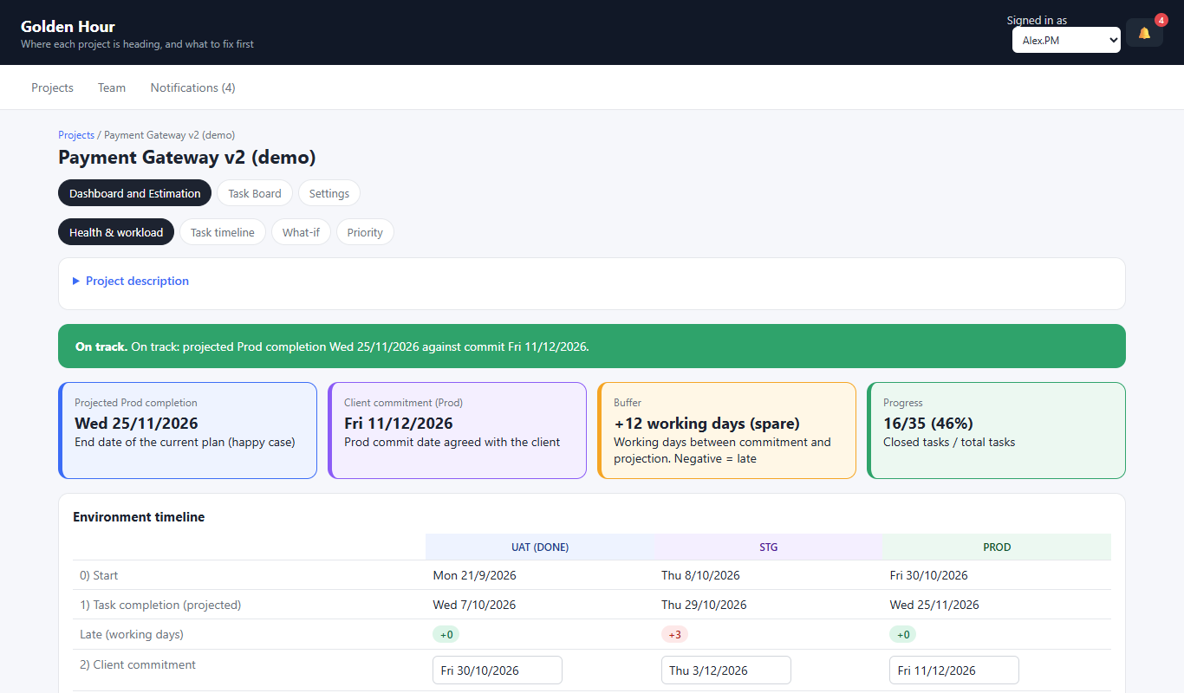
One dashboard, four numbers that matter
THE SOLUTION AT A GLANCE
Projected Prod
end date of the current plan
Client commitment
the date we promised
Buffer
working days between them; negative = late
Progress
closed tasks out of total
Notes:
This is the top of the dashboard. A leader only needs the green or red banner and the buffer. The PM scrolls down for the environment timeline, the Gantt chart, the dependency tree, what-if and priority. Stack in plain words: a web app, a database, and hosting that also sends alerts every morning at 8.

Slide 16
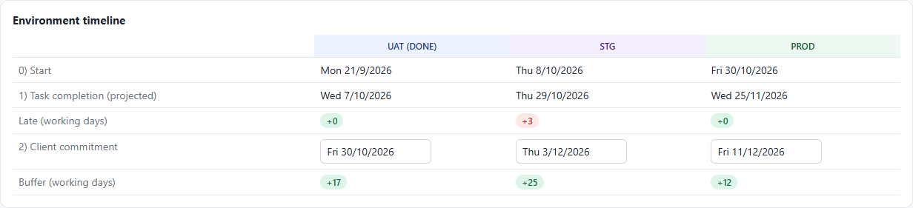
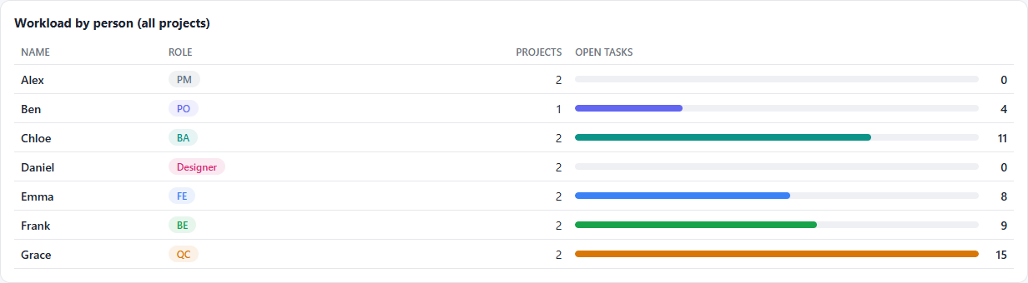
Is each environment on time, and is anyone overloaded?
SCREEN · HEALTH & WORKLOAD
① Environment timeline
For UAT, STG and Prod: start, projected finish, late days, the client date (editable), and the buffer. Green = spare days, red = late.
② Workload by person
Every member across all projects: role, projects, open tasks. Spot overload before it becomes a delay, e.g. Grace (QC) has 15 open tasks.
Above these: the health banner (On track / Late) and the four key figures from the previous slide
Notes:
The first tab of the dashboard. Environment timeline: for each environment, when it starts, when it is projected to finish, how many working days late it is, the date we promised the client, and the buffer between them. The client date can be edited right here and saves straight away. Late days are the largest late value in that environment, not the sum, because parallel late tasks share the same days. Workload by person counts open tasks across all projects, so the PM can see who is overloaded before giving them more.

Slide 17
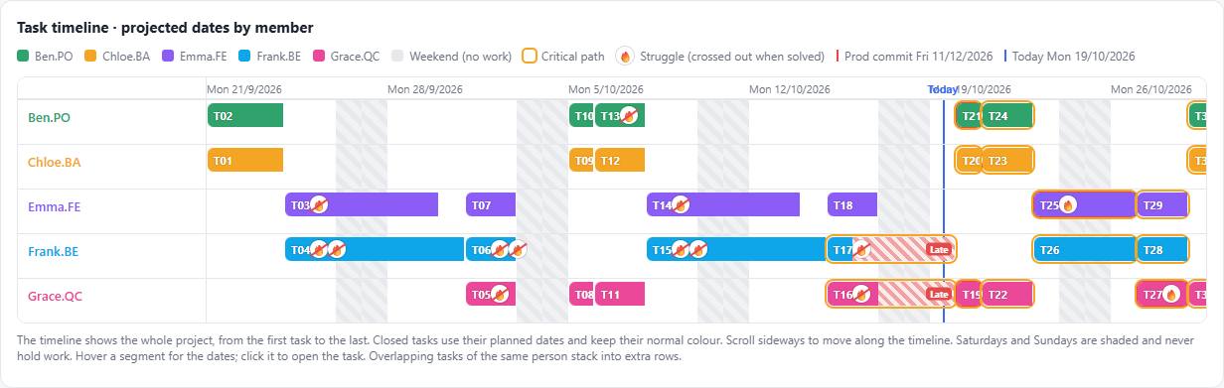
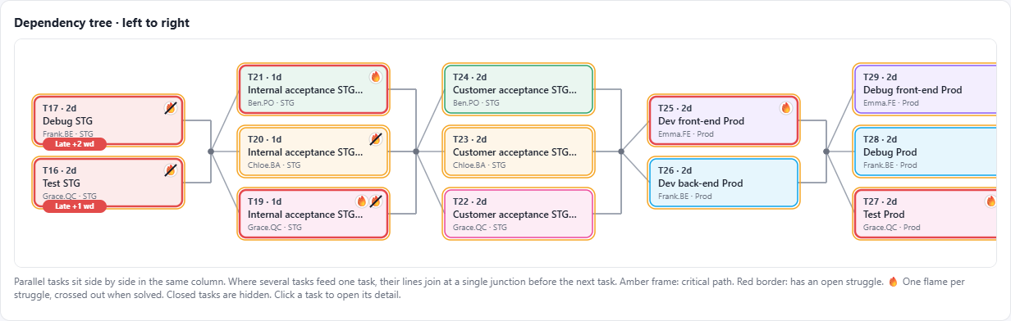
Who is doing what, and what waits on what
SCREEN · TASK TIMELINE
① Gantt chart
One lane per person, whole project. Red stripes + “Late” tag = late days. Amber outline = critical path. 🔥 = struggle. Blue line = today; red dashed line = Prod commitment.
② Dependency tree
Tasks flow left to right; tasks in one column run in parallel. Late tasks show “Late +N wd”. You see how far one delay will ripple.
Click any bar or box to open the task detail
Notes:
The Gantt answers who is doing what and when. A late task’s bar ends today, and every task after it moves later by the same number of working days, so the chart always shows the real projection, not the original plan. The dependency tree answers the question status tools usually miss: what depends on what. If a box on the left is red, everything to its right is at risk. This is exactly the ripple the hackathon prompt asked about.

Slide 18
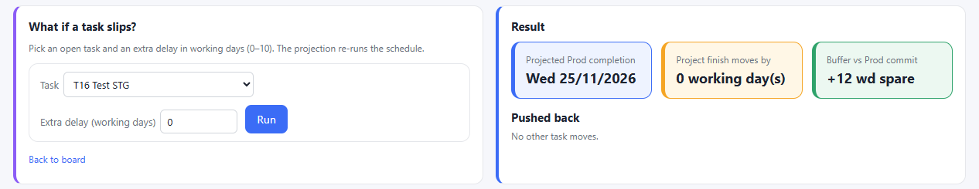
Test a delay before it happens
SCREEN · WHAT-IF
Input
Output
Use it when
Pick an open task and add 0–10 working days of delay
New Prod finish, how far it moves, buffer vs. commitment, and which tasks get pushed
Someone asks “can I have 3 more days?”, or before promising a date
Nothing is saved: it only re-runs the schedule
Notes:
What-if turns a debate into a number. If a developer asks for three more days, the PM picks the task, enters 3, and sees immediately whether the Prod date moves and by how much. In this example, Test STG has slack, so a delay moves nothing and the buffer stays at 12 spare days. The same delay on a critical-path task would push the finish date. Nothing is saved; it only re-runs the schedule.

Slide 19
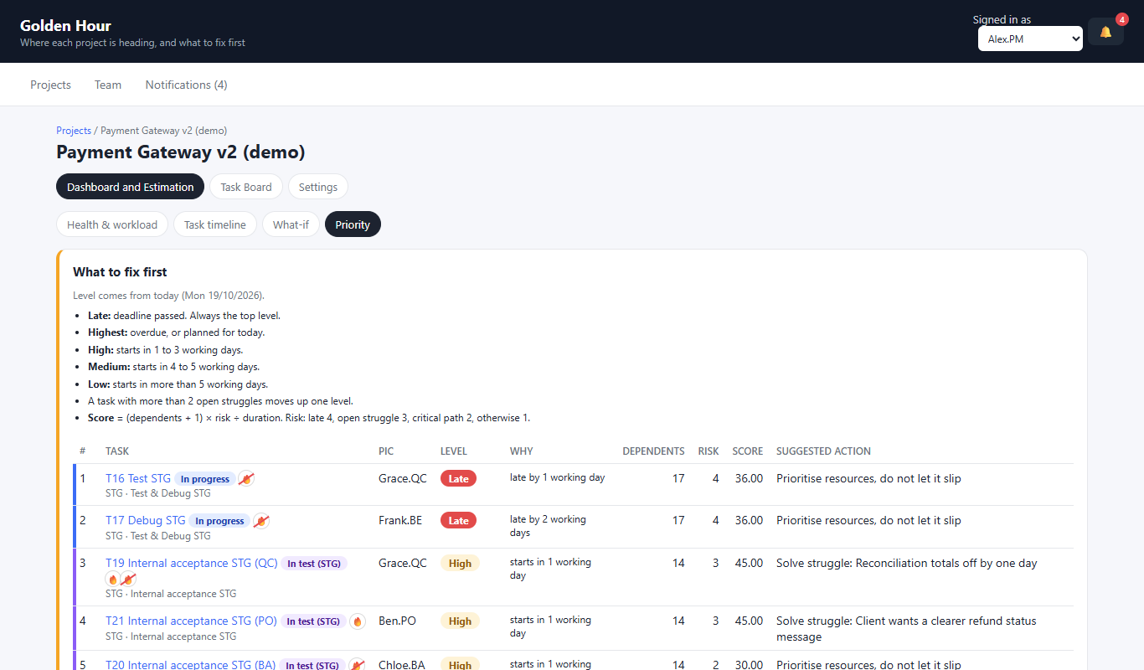
Five levels, set by today’s date
SCREEN · PRIORITY — WHAT TO FIX FIRST
Late
Deadline passed and the task has started. Always on top.
Highest
Planned end has passed, or it is planned for today
High
Starts in 1–3 working days
Medium
Starts in 4–5 working days
Low
Starts in more than 5 working days
🔥 Bump-up rule: more than 2 open struggles moves a task up one level
Each row also shows the reason and a suggested action, e.g. “Solve struggle: vendor API not delivered”
Notes:
The priority list answers the third question: what to fix first. Every open task gets one of five levels, based on today’s date in working days. Late is always on top: the deadline has passed and the task has started. Highest means it is overdue or planned for today. High starts within 1 to 3 working days, Medium within 4 to 5, Low later than that. A task with more than two open struggles moves up one level, because it is very likely to slip. Each row also says why it is there and what to do, for example solve the struggle, or protect a critical-path task. If asked how tasks are ordered inside one level: by how many tasks depend on it, its risk, and its duration.

Slide 20
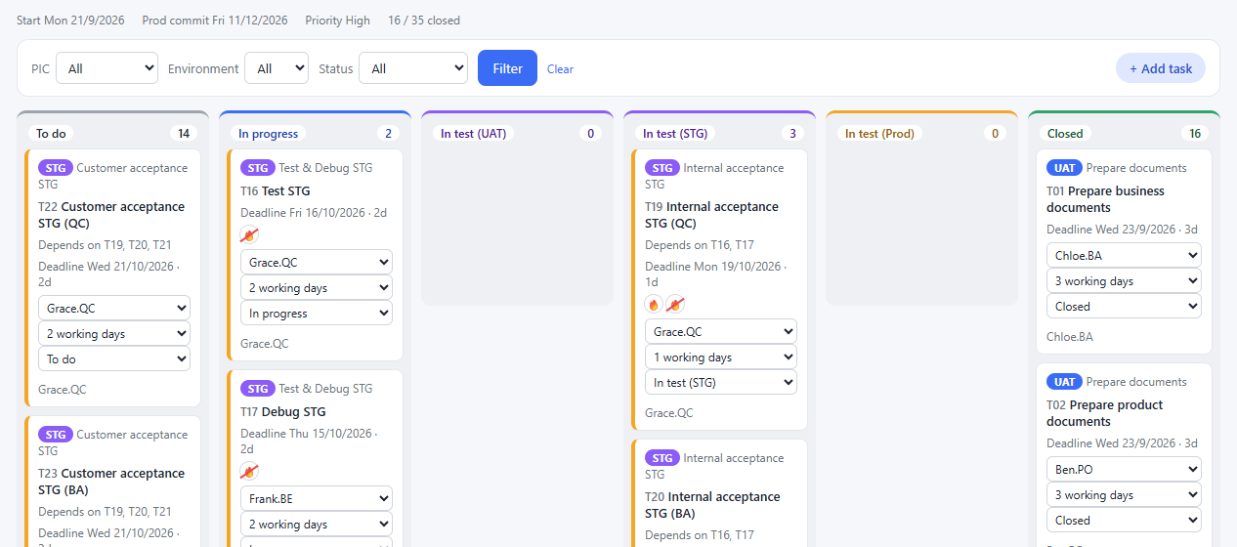
Where the team updates its work every day
SCREEN · TASK BOARD
6 columns by status
To do · In progress · In test (UAT / STG / Prod) · Closed
Each card
Environment, deadline, depends on, owner, duration, status, one 🔥 per struggle
Quick updates
Change owner, duration or status on the card; members only on their own tasks
Filters
By owner, environment or status · “+ Add task” for PM and PO
Every update here feeds the dashboard straight away
Notes:
The dashboard is only as good as its data, so updating must be fast. Team members change status, owner or duration right on the card, without opening anything. They can only edit their own tasks; the server checks this. Filters let each person see just their work, or a PM see just one environment.

Slide 21
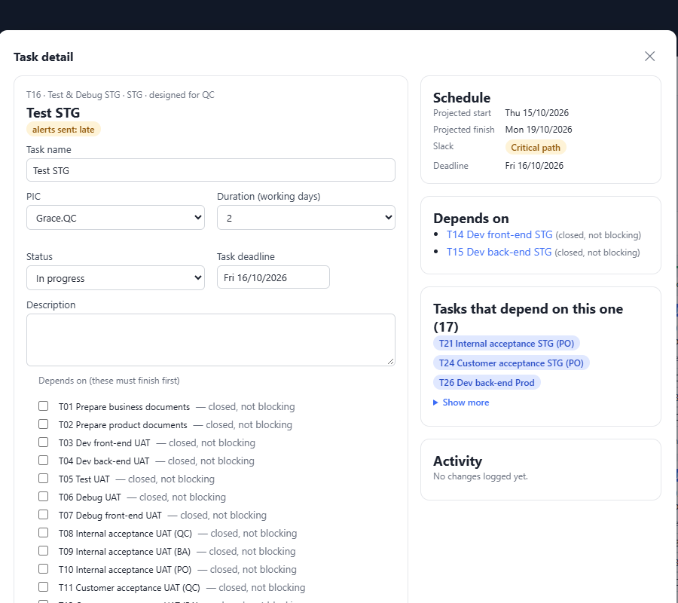
Everything about one task, in one popup
SCREEN · TASK DETAIL
Edit
Name, owner, duration, status, deadline, description
Struggles 🔥
Add a blocker with a reason; mark it solved or reopen it
Output links
PRD, SRS, test evidence, design, code / PR…
Schedule
Projected start and finish, slack or “Critical path”
Dependencies, both ways
What it waits on, and what waits on it: 17 tasks for Test STG
Opens from the board, the Gantt or the dependency tree
Notes:
This is where a team member flags a struggle. They give a reason, for example the vendor API has not arrived, and the flame appears everywhere: board, Gantt and tree. The right side shows the schedule and the dependencies in both directions. Seeing that 17 tasks depend on Test STG tells everyone why it matters.

Slide 22
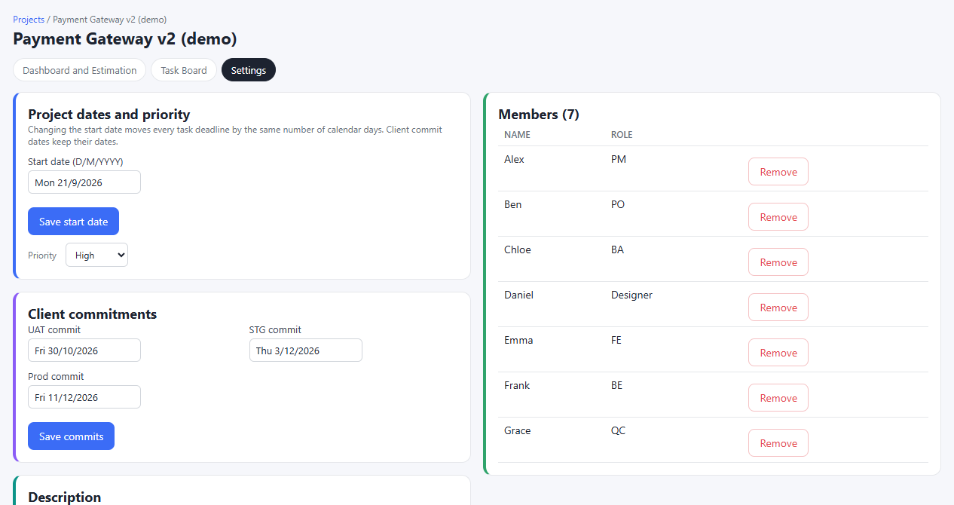
Dates, commitments and the team
SCREEN · SETTINGS
Start date & priority · PM
A new start date moves every task deadline with it
Client commitments · PM, PO
UAT, STG and Prod dates the buffer is measured against
Description · PM, PO
Context, client info, related document links
Members & delete · PM
Add or remove people; the demo project is locked against deletion
Each section shows who can change it; the server enforces the same rule
Notes:
Settings is where the PM controls the frame of the project. Only the PM can move the start date, set priority, manage members or delete a project. The PO can also change client commitments and the description, because the PO talks to the client about scope and dates. The demo project is locked so that nobody can delete it during testing.

Slide 23
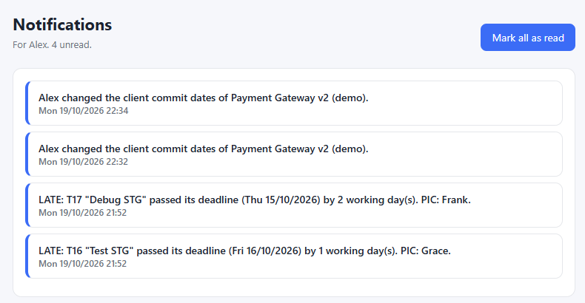
The tool speaks up, so no one has to check
SCREEN · NOTIFICATIONS
Two early-warning alerts
LATE: a task passed its deadline
To do too long: not started after 2 working days
When
Every day at 8:00, and when a project page opens; once per task until it changes
Who
Alerts → whole project. Task changes → PM, PO and the owner
In-app with a bell and unread count today · Slack, Teams and email are on the roadmap
Notes:
The prompt said managers find out at the deadline. Alerts fix that: the morning a task becomes late, the whole project is told, with the task, how many days late, and who owns it. A second alert catches tasks that sit in To do too long, which is often the earliest sign of trouble. Each alert is sent once, so it does not become noise.

Slide 24
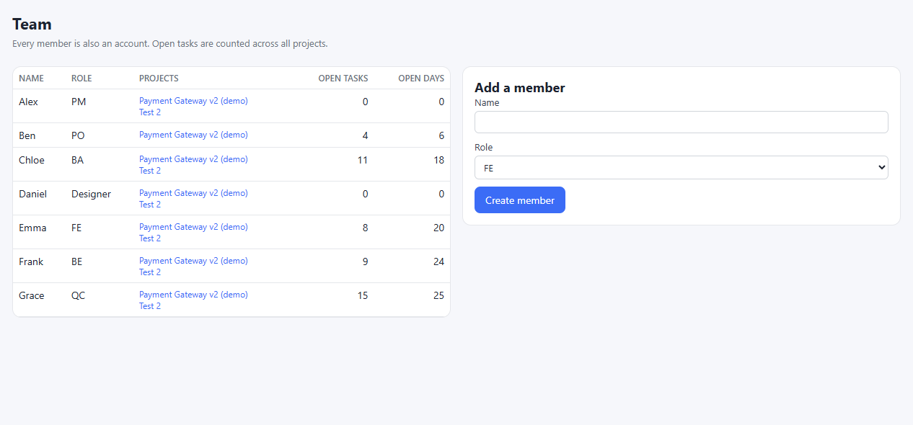
Capacity across all projects
SCREEN · TEAM
Per member
Role, projects, open tasks and open working days
Add a member
PM only: name and role
Why it matters
Grace (QC) has 25 open days across 2 projects: the next bottleneck, visible before it hits
Every member is also an account in the “Signed in as” menu
Notes:
Delays often come from people, not tasks: one person shared across projects. The Team page shows each person’s open work across every project, so the PM can rebalance before assigning more. In the demo, QC has the most open days, which matches the testing-heavy second half of the flow.

Slide 25
Pretend today is another date
FEATURE · TEST CLOCK
TEST CLOCK: Mon 26/10/2026
Status changes are not saved. Closing the tab or turning the clock off returns to real time.
Change date · Exit
Illustration of the bar shown in the header while the test clock is on
Why
How
Safe
Late rules and alerts depend on today. Without it, testing them means waiting days.
Pick any date in the header. All date logic uses it, and you can change task status to replay a scenario.
Kept in this browser only, never in the database: no notifications, no logs. A new tab is back to real time.
Added after the hackathon (1/11) to check the late and closed-task rules
Notes:
This is a tool I built for myself, and it changed how I worked with the AI. Most rules in Golden Hour depend on today’s date: whether a task is late, how far its successors move, when alerts fire. To check them I would have had to wait days. With the test clock I jump to any date, close or reopen tasks, and see whether the Gantt and the numbers match what should happen. That is how I found and fixed the scheduling issues after the hackathon. It is safe for a shared demo: nothing is written to the database.

Slide 26
“Back-end dev is blocked by a vendor API”
LIVE DEMO · ONE STORY
1
Add a 🔥 struggle: the task is flagged
2
Gantt: every task after it shifts later
3
Buffer turns negative, Health goes red
4
What-if: “+3 days?” shows the new finish
5
Priority list: what to fix first, and why
6
Switch to Emma.FE: she edits only her tasks
Demo: golden-hour-pm.vercel.app · project “Payment Gateway v2 (demo)”
Notes:
Switch to the live app now (about 4 minutes). Tell it as one story rather than a tour of tabs. Open the demo project as Alex.PM, add a struggle on the back-end dev task, show the Gantt shift, the buffer and health change, try +3 days in what-if, open Priority, then switch to Emma.FE to show permissions. Keep screenshots ready as a backup in case the app is slow to wake up.

Slide 27
How I built it
04

Slide 28

Spec first, then build, then test against real cases
MY AI WORKFLOW
Me
Claude chat
Claude Code
Me
Loop
Understand the problem
Write the spec
Build from the spec
Test with real scenarios
Fix the rule, rebuild
Claude chat → the logic
Claude Code → the code
Turned the business problem into rules: roles and permissions, the 35-task flow, scheduling formulas, late rules, alerts, edge cases. Output: CLAUDE.md, a 372-line spec.
Read the spec and built the app: database, screens, permission checks, automated tests, deployment. When a number looked wrong, I fixed the rule first, then asked it to update the code.
Spec-first: the spec is the source of truth, and the code must match it
Notes:
This is the core of how I work. I never asked the AI to just build a project tracker. First I used Claude chat to think through the business rules and write them into one spec file. Then Claude Code built from that spec. Then I tested with realistic scenarios. When something looked wrong, I did not patch the code directly; I fixed the rule in the spec and had Claude Code rebuild. That way the spec and code always agree, and anyone can maintain it later. Have the tools open in case the panel wants to see them.

Slide 29
Four simple parts, each chosen for a reason
TECH STACK
SCREENS
LOGIC
DATA
HOSTING
Next.js + React
Server actions
Supabase (Postgres)
Vercel + Cron
Dashboard, Gantt, task board, settings. Written in TypeScript.
Scheduling engine, and every write. All permission rules live in one file.
Deploys on every push. Sends alerts daily at 8:00 Vietnam time.
Projects, members, tasks, dependencies, struggles, notifications.
Why: one codebase for screens and server logic; AI tools know it well.
Why: a hidden button can’t be bypassed by a direct request.
Why: no server to manage; runs in Seoul, close to users.
Why: task links fit a relational database; free tier; SQL I can read.
Also used:
GitHub
Automated tests (Node test runner)
Claude chat
Claude Code
Cost to run the demo: free tiers of Supabase and Vercel
Notes:
I kept the stack small on purpose: four parts, all managed services, so I spent my three days on the business logic instead of on servers. Next.js lets screens and server code live in one project, and it is a stack Claude Code works with very reliably. Every change goes through server actions, and all permission rules sit in one file, so they are easy to review and later to connect to a real login. Supabase gives a real Postgres database, which suits tasks that depend on other tasks. Vercel deploys on every push to GitHub and runs the daily 8 a.m. alert job. Both run in Seoul, the closest region to Vietnam. [Adjust the “why” lines to match your own reasons.]

Slide 30
Live in 3 days, then kept improving
TIMELINE & ITERATION
17/10
18/10
19/10
23/10
1/11
Idea, scope and spec
First working app, deployed
Design, docs, submitted
Reactivate supabase
Reactivate supabase + add clock for testing
3
27
~5.3k
372
days to a live app
commits
lines of code
lines of spec
Notes:
Be transparent: the hackathon submission was 19 October. After that I kept going on my own, because testing with realistic dates showed some scheduling rules were not quite right, for example how late days are counted and how closed tasks affect the tasks after them. That is the iterate loop in practice.

Slide 31
Results & next steps
05

Slide 32


What works today, and what doesn’t yet
RESULTS
Delivered
Limitations
Live, deployed app anyone can try
Answers all 3 questions on one screen
Role permissions checked on the server
Daily alerts for late and stuck tasks
User guide + full spec for maintainers
No real login yet
No public holidays
Alerts are in-app only
Tested on demo data, not a live project
No UT
Fixed roles: new roles can’t be added freely
Fixed flow: no urgent or hot-fix tasks
No overlap, e.g. docs and dev in parallel
Golden Hour · Mabel Nguyễn
Notes:
Be honest here. The app works end to end and is live. But it has no real login, no holidays, alerts stay inside the app, and it has only been tested on demo data. The model is also simplified: the six roles are fixed, so a team with a Designer, DevOps or a second QC can’t be set up freely yet. The flow is strictly step by step, so it doesn’t cover real-life cases like an urgent task that jumps the queue, or the team overlapping documentation and development. These are the next things I’d make configurable. [If anyone tried it and gave feedback, say who and what you changed.]

Slide 33
From demo to a tool a real team uses
WHAT’S NEXT
1
2
3
4
Real sign-in
Jira sync
Alerts where people are
Weekly snapshots
Higher security; each person sees only their projects
Import tasks first, then two-way sync, so no one types twice
Is the project getting better or worse over time?
Slack, Teams and a daily email digest
Golden Hour · Mabel Nguyễn
Notes:
The roadmap is ordered by what a real team would need first: secure access, then removing double data entry by syncing with Jira, then alerts in the channels people already use, then trends over time.

Slide 34
What I learned
06

Slide 35
Three lessons I’ll bring to the next tool
WHAT I LEARNED
1
A clear spec makes AI far more accurate
2
Testing with real scenarios catches what the AI can’t see
3
Ship early, then iterate on what you learn
Golden Hour · Mabel Nguyễn
Notes:
Close with the lessons, and link them to the role: this is exactly the loop I would use with the Digitization Service team. Understand the workflow, write the rules down, build fast, test with real cases, and iterate.

Slide 36
Thank you
Q&A
Happy to go deeper on any decision
Live app: golden-hour-pm.vercel.app
Mabel Nguyễn
Code: github.com/Julie-hub-source/Golden_Hour_PM
Notes:
Thank you. I’m happy to take questions, show the spec, open Claude Code, or walk through any scenario you’d like to test.

